Slide 1

Redistricting for Journalists
South Carolina Press Association
March 26, 2021

Slide 2
Redistricting: The Process

Slide 3
Process: Data
Already released, 2020 Census Geography
By the end of September 2021, the Census Bureau will deliver to the General Assembly and publicly release data used for redistricting: the Public Law 94-171 files.

Slide 4
Process: Redistricting Criteria
The redistricting subcommittees of House and Senate Judiciary will review and adopt the criteria to be used in drawing maps. The two Houses usually differ on criteria.

Slide 5
Process: Drawing the Maps
As soon as the PL 94-171 is loaded onto computers, staff and members will one-by-one or by delegation retreat to the Map Rooms to draw maps using Caliper’s Maptitude for Redistricting software.
Who’s in Charge?
House
Judiciary Cttee., Elections Laws Subcommittee, Rep. Wallace H. “Jay” Jordan, Jr., Chair
Staff: Patrick Dennis, General Counsel
Senate
Judiciary Committee, Reapportionment Subcommittee, TBD
Staff: Andy Fiffick, Chief of Staff
Charles Terrini, attorney
Will Roberts, demographer

Slide 6
Process: Public Hearings
The Redistricting committees typically hold public hearings around the state to hear from voters about desires, communities of interest and so forth.
Watch for: The lateness of redistricting data in 2021
may result in fewer public hearings.

Slide 7
Process: Submission of Plans by Other Parties
The two bodies will establish procedures for submission of proposed plans by outside parties, typically before the subcommittees start amending staff plans.
In 2011, the ACLU and the Republican Party submitted proposed Senate plans.
The ACLU, NAACP, Congress member James Clyburn, Congress members Mick Mulvaney and Joe Wilson and John Kuhn submitted proposed Congressional plans.
As mapping software becomes more accessible, more private parties, like the League of Women Voters of South Carolina, will likely submit plans.

Slide 8
Process: Passage
Redistricting plans progress from subcommittee to Full Judiciary Committees and then to the Floor just like other pieces of legislation with amendments considered through the process.
Senate Rules don’t allow Calendar games on a reapportionment bill. Any such bill is placed in the masthead position and must be taken up daily after the conclusion of the Uncontested Local Calendar.
The House and the Senate typically don’t touch one another’s redistricting bills. They simply pass them.
The Governor may sign or veto a reapportionment bill.
If the Governor vetoes, someone will bring a lawsuit under One Person One Vote.

Slide 9
Redistricting: The Legal Foundation

Slide 10
The Legal Foundation: Federal Constitution
14th Amendment
One Person, One Vote or Equipopulous Districts
Baker v. Carr, 369 U.S. 186 (1962) – redistricting is a justiciable question
Reynolds v. Sims, 377 U.S. 533 (1964)—state legislative districts should be roughly equal in population
Equal Protection
Racial Gerrymandering, Shaw v. Reno, 509 U.S. 630 (1993). Redistricting based on race must be held to a standard of strict scrutiny under the equal protection clause.

Slide 11
The Legal Foundation:
Federal Constitution, cont.
Fifteenth Amendment
Section 1: “The right of citizens of the United States to vote shall not be denied or abridged by the United States or by any State on account of race, color, or previous condition of servitude.”
Section 2: “The Congress shall have the power to enforce this article by appropriate legislation.”

Slide 12
The Legal Foundation: Voting Rights Act
Voting Rights Act of 1965, as amended
Section 2 prohibits voting practices or procedures that discriminate on the basis of race, color, or membership in one of the language minority groups identified in Section 4(f)(2) of the Act. Those involve:
Vote Denial
Vote Dilution
Section 5, which formerly required preclearance of any South Carolina change in voting practice or procedure by the U.S. Department of Justice or the Washington, D.C., District Court, was effectively nullified in Shelby County v. Holder, 570 U.S. 529 (2013). South Carolina jurisdictions do not currently have to submit redistricting plans for preclearance.

Slide 13
The Legal Foundation: Voting Rights Act, cont.
Section 2 Vote Dilution:
“[The] essence of a Section 2 claim is that a certain electoral law, practice, or structure interacts with social and historical conditions to cause an inequality in the opportunities enjoyed by black and white voters to elect their preferred representatives." Thornburg v. Gingles, 478 U.S. 30, 47 (1986).
Courts evaluating a districting plan under Section 2 currently look to whether, given the totality of circumstances, a districting plan results in a dilution of the ability of minority voters to elect candidates of the choice. Courts are bound by Section 2 in drawing maps.
Typically vote dilution results from at-large elections or packing or cracking single-member districts. Packing far more minority voters into a district than is required to elect a candidate of choice reduces the ability of minority voters to elect candidates of their choice in other districts. Cracking concentrations of minority voters into adjoining districts deprives them of the ability to elect candidates of their choice.

Slide 14
The Legal Foundation:
VRA vs. Racial Gerrymandering
“Avoiding minority vote dilution under § 2 may require the creation or maintenance of particular majority-minority districts, even on a predominately racial basis, if this can be done in a reasonably compact manner, taking into account traditional districting principles.”
Colleton County Council v. McConnell, 201 F. Supp. 2d 618 (D.S.C. 2002), 44
However, those districts must be narrowly tailored to avoid liability under Section 2. In the 90s and into the early 2000s, litigation challenging majority minority districts focused on compactness and “bizarre” district shapes, efforts to create as many majority minority districts as possible and putting race ahead of traditional districting principles. See, Smith v. Beasley and Able v. Wilkins, 946 F. Supp. 1174 (D.S.C. 1996).

Slide 15
The Legal Foundation:
VRA vs. Racial Gerrymandering, cont.
In the past decade, minority advocates have used the failure of legislatures to narrowly tailor majority-minority districts to challenge legislative districts. The successful challenges focused on:
Plans that set an overall minority target for majority-minority districts resulting in districts “packed” with minority populations in excess of populations need to narrowly tailor a Section 2 remedy.
Plans drawn without conducting racial bloc voting analyses or presenting other evidence to determine the levels of minority populations needed to provide an equal opportunity for minority populations to elect candidates of their choice.

Slide 16
The Legal Foundation:
Wither the VRA
Although focused on vote denial claims, cases are making there way through the federal Courts which challenge Voting Rights Act protections for minority voters.
The U.S. Supreme Court recently heard Brnovich v. Democratic National Committee and Arizona Republican Party v. Democratic National Committee (Docket No. 19-1258). Those consolidated cases could result in major changes to Voting Rights law, for example by replacing a results standard with an intent standard, requiring minority citizens to prove that the legislature intended to dilute minority voting strength. That’s a very high bar.
Redistricting in 2021 may be operating under a very different legal framework than has been the case since the 1990s.

Slide 17
Redistricting: The Census

Slide 18
The Census: Who Is Counted?
“Representatives shall be apportioned among the several States according to their respective numbers, counting the whole number of persons in each State, excluding Indians not taxed.” –U.S. Constitution, Fourteenth Amendment, Section 2
Also, summaries for the major race groups specified by OMB directive:
White, Black/African American, American Indian/Alaska Native, Asian, Native Hawaiian/Other Pacific Islander, plus ‘some other race’
Multi-racial combinations
Cross-tabulated by Hispanic/Non-Hispanic origin, voting age.
Trump administration’s attempt to include citizenship in the survey was blocked. Attempts to infer citizenship data were not implemented.

Slide 19
The Census: When, How?
Geographic data available now
Blocks, block groups, tracts, voting districts, etc.
Counts to Congress for apportionment in April
Counts in “legacy format” may be released to states in mid-August
Final delivery expected by September 30
Published at https://www.census.gov/programs-surveys/decennial-census/about/rdo/summary-files.html#P1

Slide 20
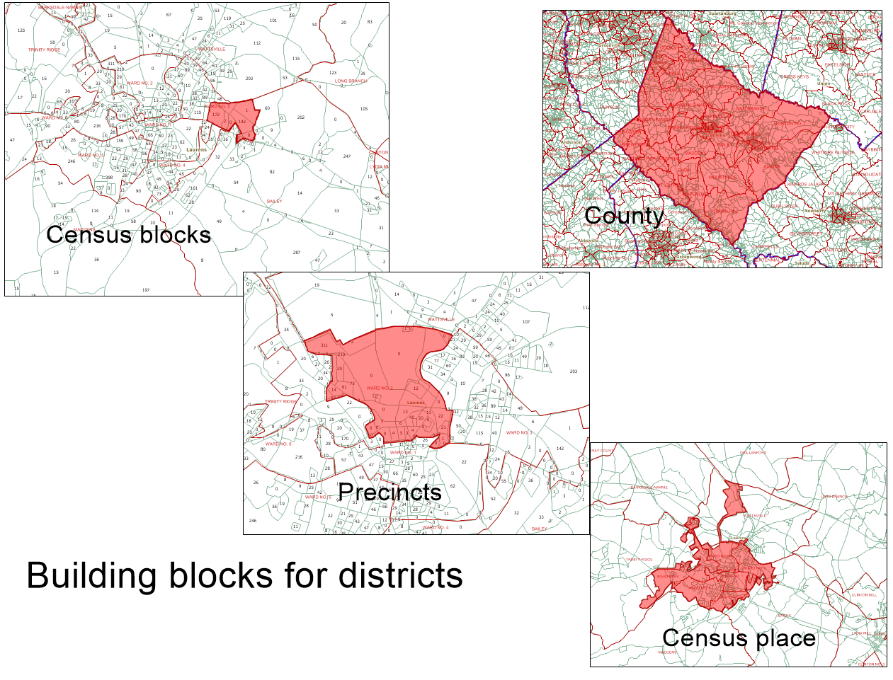
Redistricting is based on Census blocks. But you can build a district by adding a precinct, a Census place or a county to your plan.

Slide 21
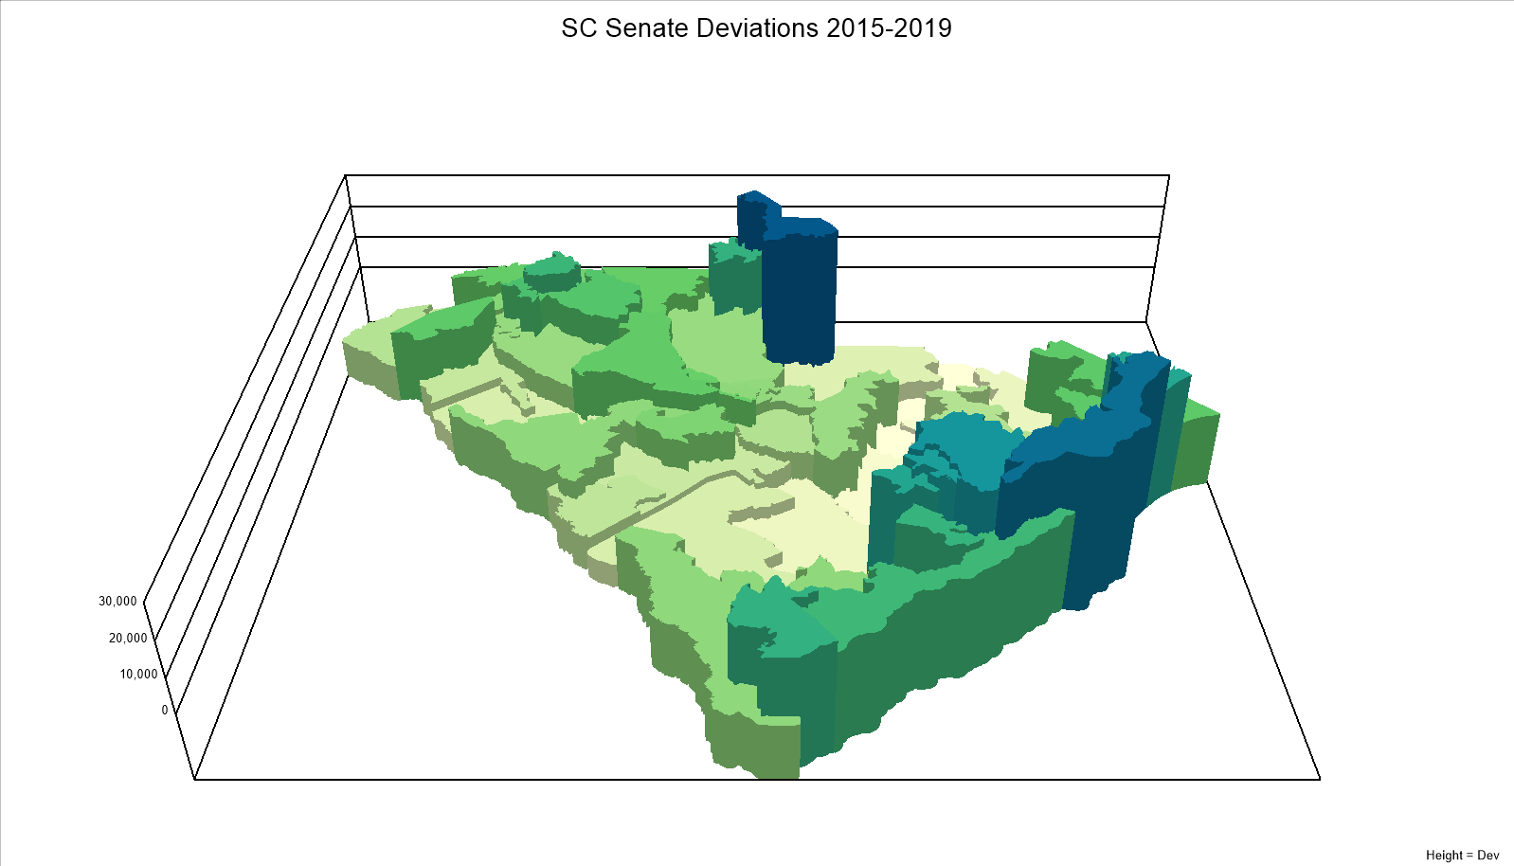
Where population is flowing to and from requiring more or fewer districts.
Based upon American Community Survey, 2015-2019 estimates.

Slide 22
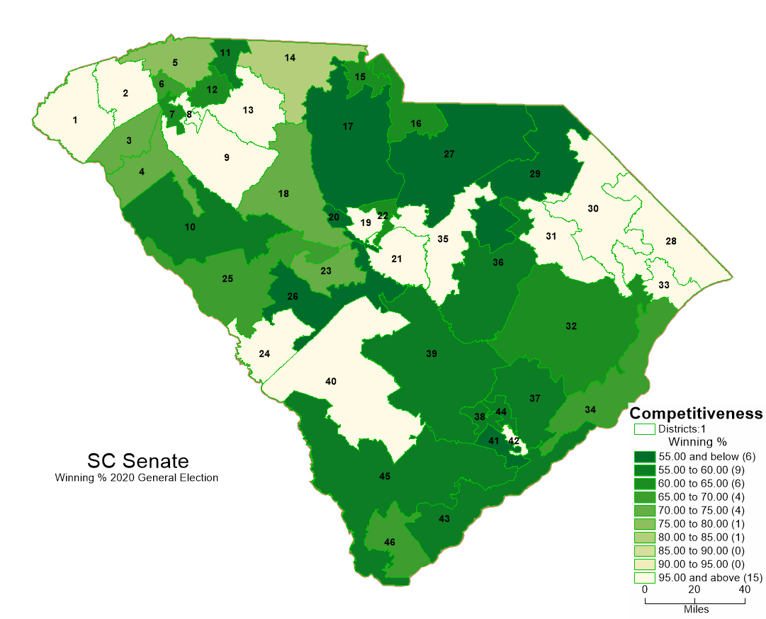
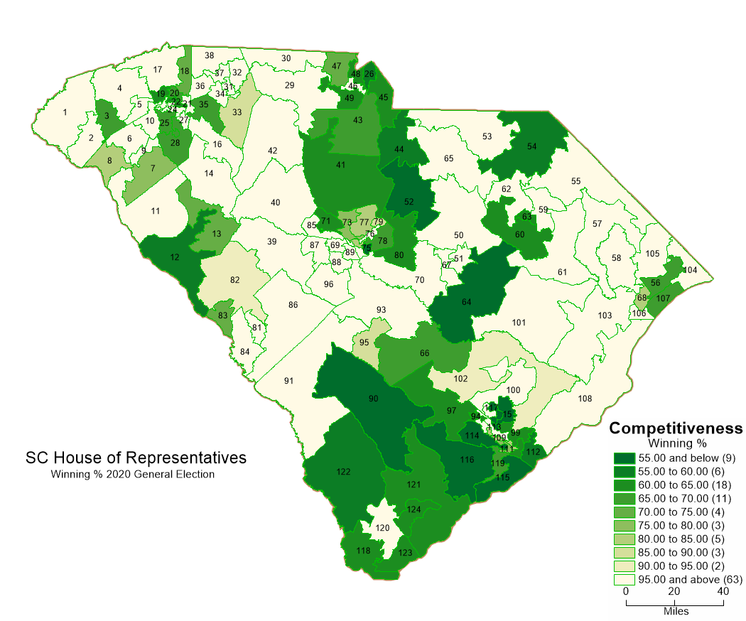
How We Draw Districts Matters to Voters
In 2020, 65 House seats and 15 Senate seats were uncontested even by minor party opponents.
When incumbents or parties draw the districts, voters may have no choice in General Elections. That reduces participation.
Candidates don’t need to appeal to the middle--leading to more polarization.

Slide 23
Redistricting: Criteria

Slide 24
Criteria: Required
One representative per district (Congress)
Equal populations
Congressional districts: within a few persons
Legislative districts: within a few percent
Contiguous (SC)
By water OK along the coast or rivers
Voting Rights Act requirements
Communities of Interest

Slide 25
Criteria: Desirable
Respect
Political boundaries
Precinct boundaries
Compact
Partisan Gerrymandering
Minimize partisan bias
Maximize competitiveness
Avoid incumbent protection

Slide 26
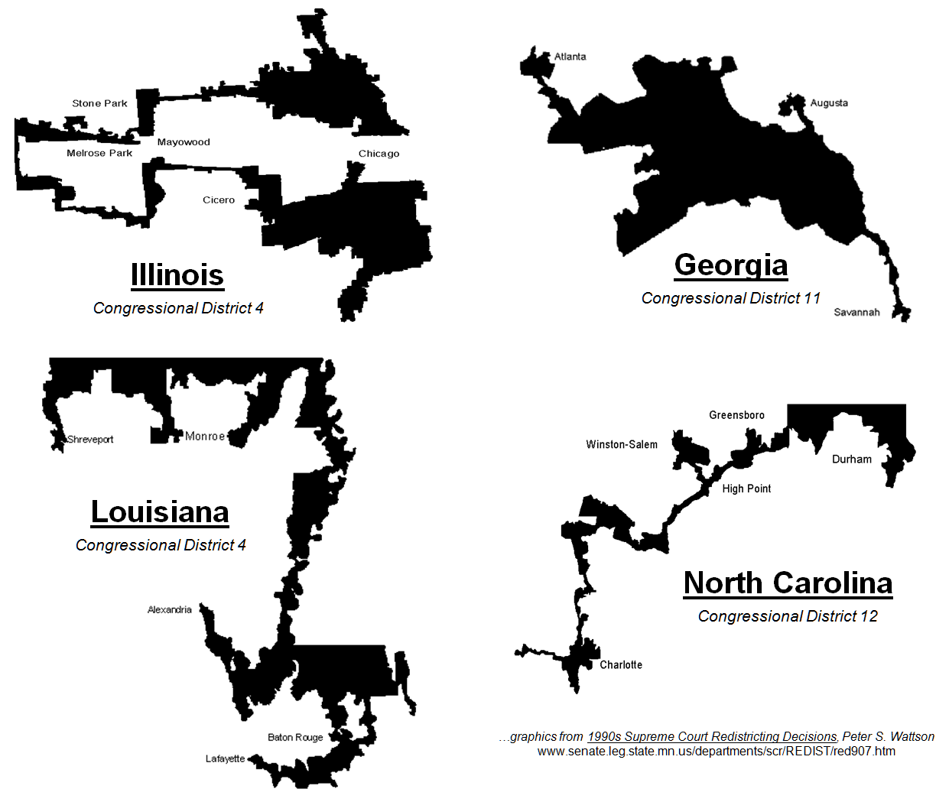
Compact?

Slide 27



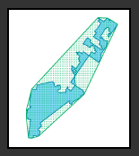
Measuring Compactness
Polsby-Popper
Schwartzberg
Eyeball Test
I don’t know what it is, but I know it when I see it.
Reock
Convex Hull

Slide 28
Compactness Summaries
 | Compactness Measures
District Plans | Inverse Polsby-Popper | Inverse Schwartzberg | Inverse Convex Hull | Inverse Reock
Current State House | 4.06 | 1.98 | 1.42 | 3.57
Current State Senate | 4.96 | 2.19 | 1.46 | 2.56
Current Congress | 6.19 | 2.41 | 1.37 | 2.56
House Exemplar | 3.56 | 1.86 | 1.34 | 2.33
Senate Exemplar | 3.92 | 1.96 | 1.36 | 2.38
Congress Exemplar | 3.95 | 1.98 | 1.31 | 2.17

Slide 29
Redistricting: When does it result in gerrymandering?

Slide 30
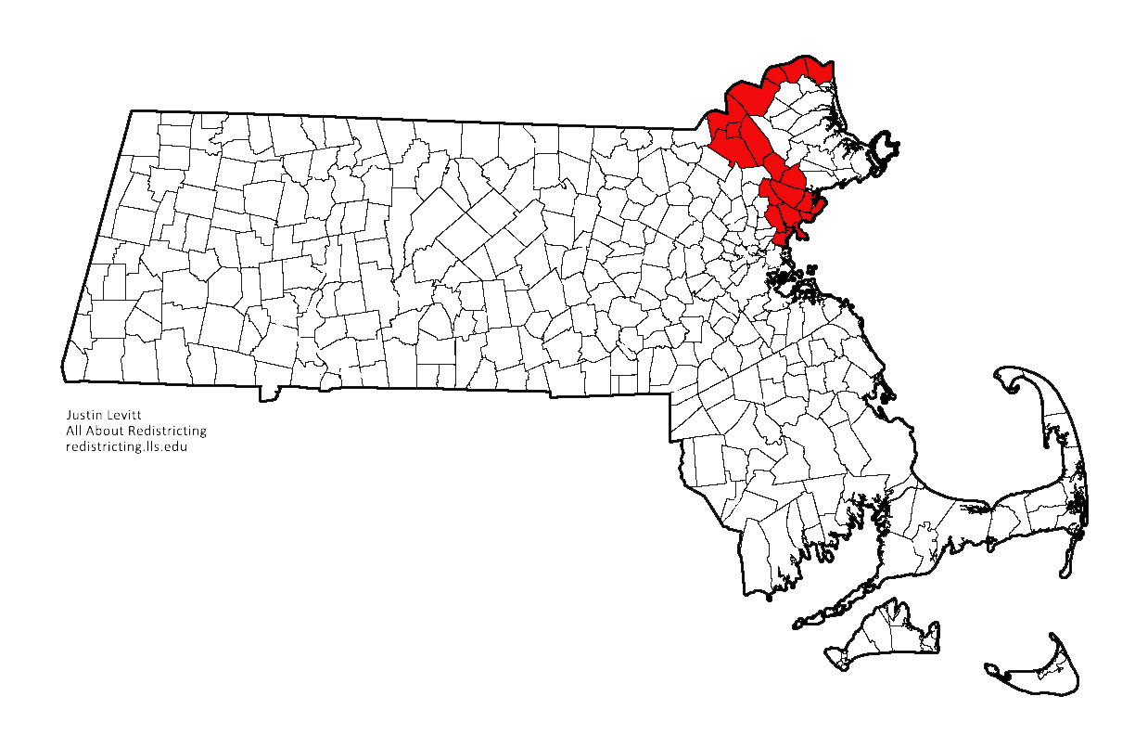
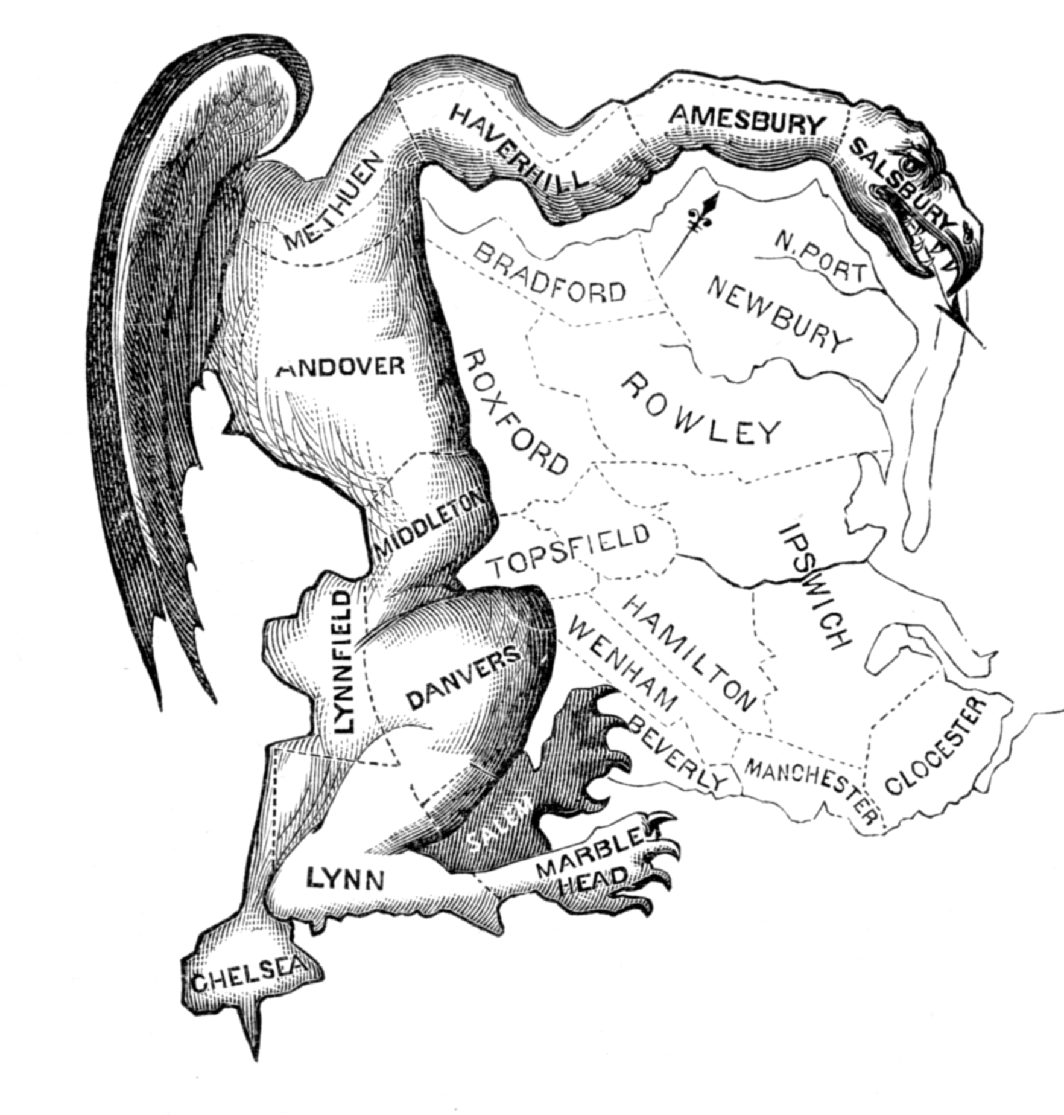
Partisan Gerrymandering
Drawing district lines to advantage one party
Now can achieve very precise mixes using computers and public or proprietary data
Party registration
Primary ballot selection
Demographic data

Slide 31
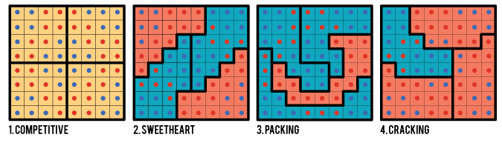
How to Gerrymander
Packing: Concentrating communities into a few districts where they win overwhelmingly, but not enough seats to have influence
Cracking: Splitting communities among several districts to ensure they don’t constitute a majority in any

Slide 32

How to Gerrymander
Gerrymandering by the Numbers
From the film Line in the Street

Slide 33
Measuring Partisan Gerrymandering
Efficiency gap
Compare wasted votes (votes for losers, excess votes for winners)
Median-Mean
Skew in distribution of votes (mean larger than median)
Partisan symmetry
Compare how easy it is for each party to accumulate additional seats as they gain hypothetical voters

Slide 34
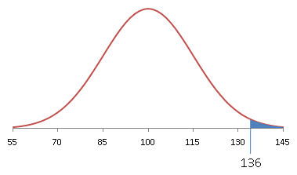
How Do You Know You’ve Been Gerrymandered?
Measures can be influenced by overall party split and natural geographic sorting
Just computing a measure for a single map doesn’t really tell you if it’s manipulated
Solution: Outlier analysis
Draw lots of random maps
Compute measures for all
How unusual is your map?
p-value

Slide 35
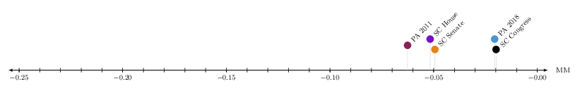
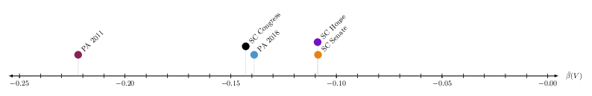
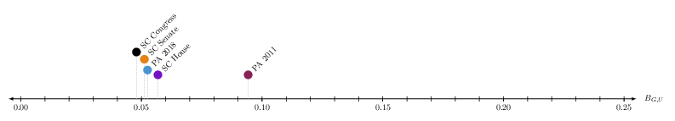
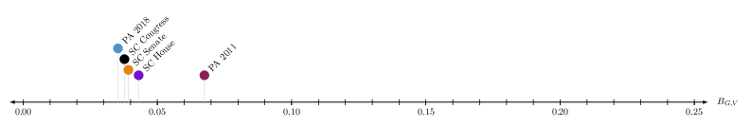
How Gerrymandered is SC Now?
Median-Mean
Bias Point
Geom. Bias (U)
Geom. Bias (V)

Slide 36
Criteria For Redistricting in SC
SC House (2011)
Population +/- 2.5%
Contiguity by water
Compactness
“Bizarre shapes are to be avoided except…” geography, population, VRA
Compare to prior plans, not mathematical formulas
Communities of interest
Protect incumbents

Slide 37
Criteria For Redistricting in SC
SC Senate (2011)
Population +/- 5%
Contiguity: No X boundaries
Other criteria
Communities of interest
Constituent consistency
County and municipal boundaries, precinct boundaries
Compactness

Slide 38
Criteria For Redistricting in SC
LWVSC (Proposed 2020)
Population +/- 5%
Contiguity by water, no X boundaries
Must not intend to discriminate for or against an incumbent, party, or candidate
Must not intend to reduce competitiveness
Compactness: avoid bizarre shapes
Respect county, municipality, precinct boundaries
Communities of interest
Economic, social/cultural, historic, geographic, gov’t services, media markets
Not partisan

Slide 39
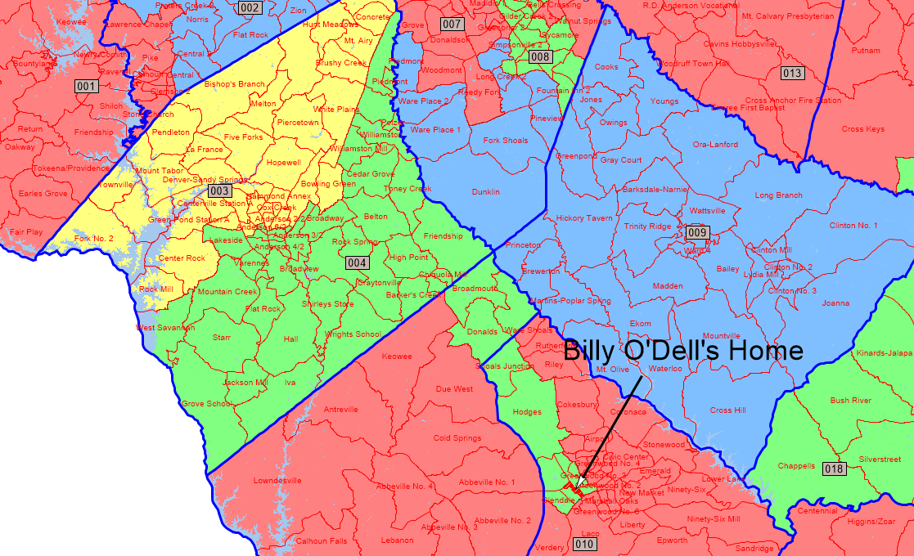

Slide 40
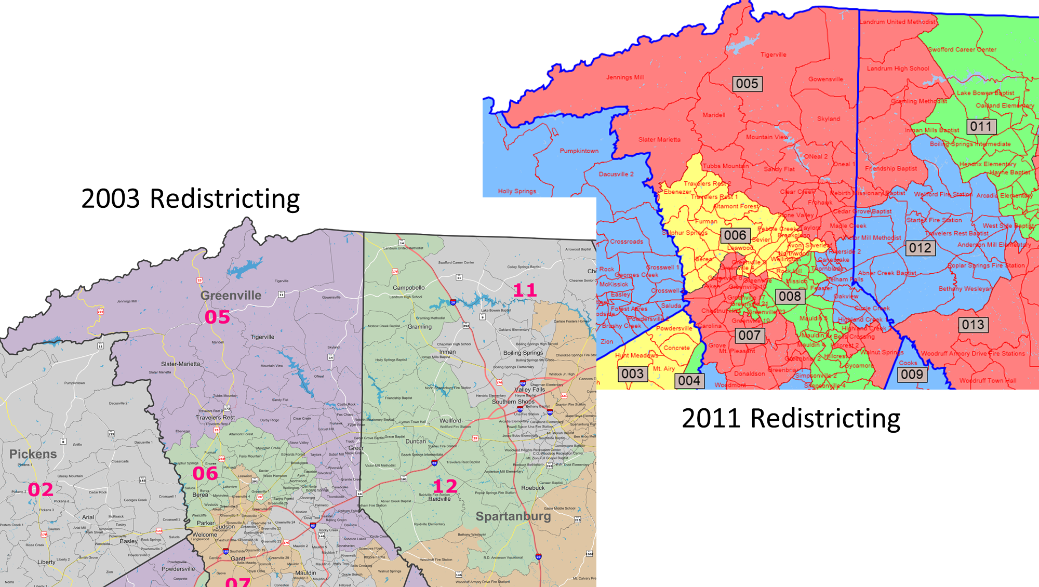
“Bright’s new district also leaves out all of the area of House District 38, represented by Rep. Doug Brannon, R-Landrum.”
S. Largen, Bright, Greenville senator would trade portions of areas in Senate redistricting plan, GoUpstate.com (June 28, 2011) at https://www.goupstate.com/news/20110628/bright-greenville-senator-would-trade-portions-of-areas-in-senate-redistricting-plan

Slide 41
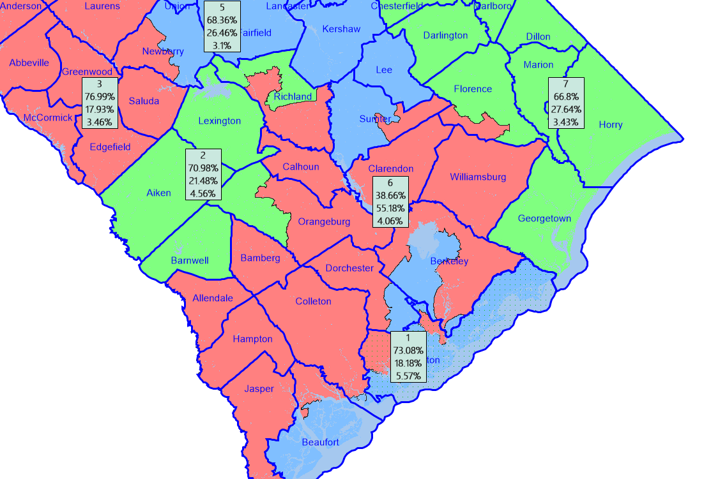
Packing Districts by Ignoring Other Minority Groups
The 6th Congressional District appears like a somewhat competitive district at 55 % NonHispanic BVAP.
But the district’s VAP is 4 % Hispanic and 2 % Native American, Asian or Other Multi-Race.
So, NonHispanic Whites are only 39 % of the VAP.
This district is not narrowly tailored to provide minority voters with an opportunity to elect candidates of their choice.

Slide 42
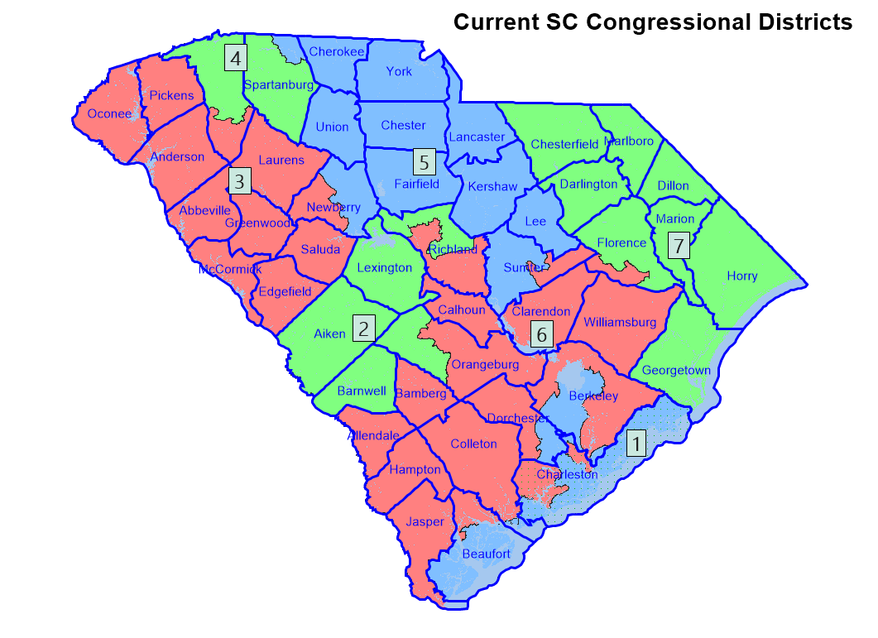
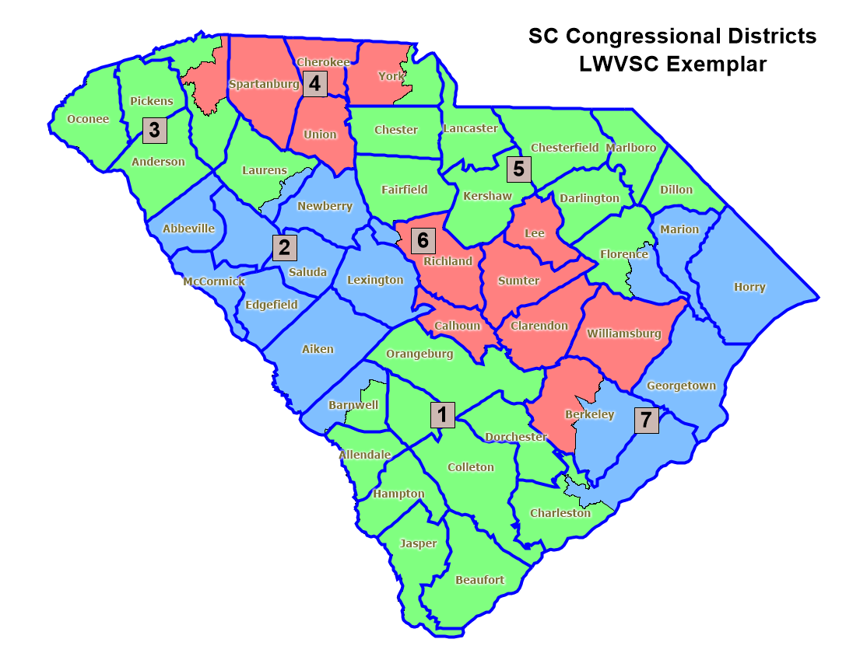
Current Congressional Districts compared to LWVSC Exemplar

Slide 43
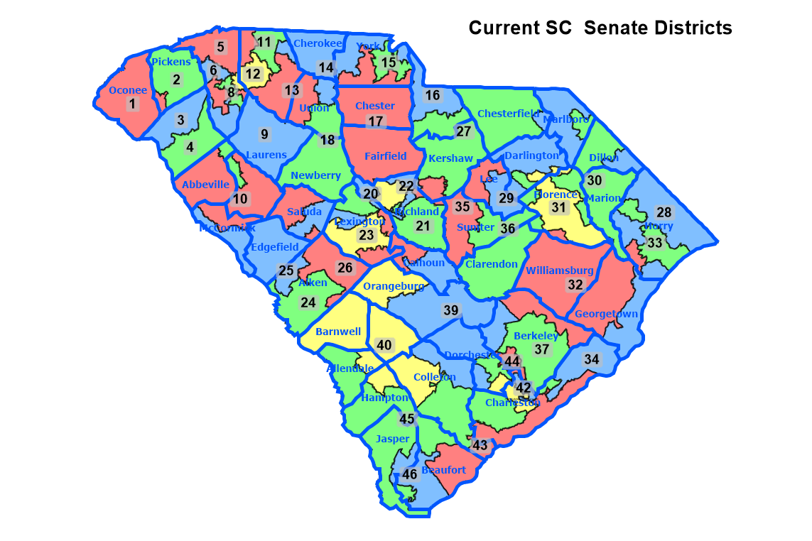
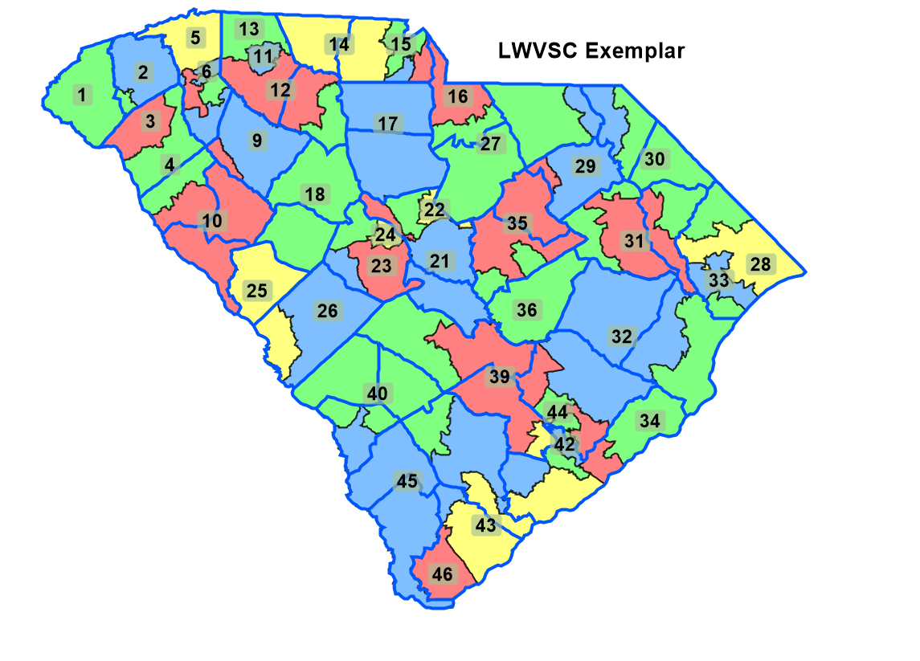
Current SC Senate Districts compared to LWVSC Exemplar

Slide 44
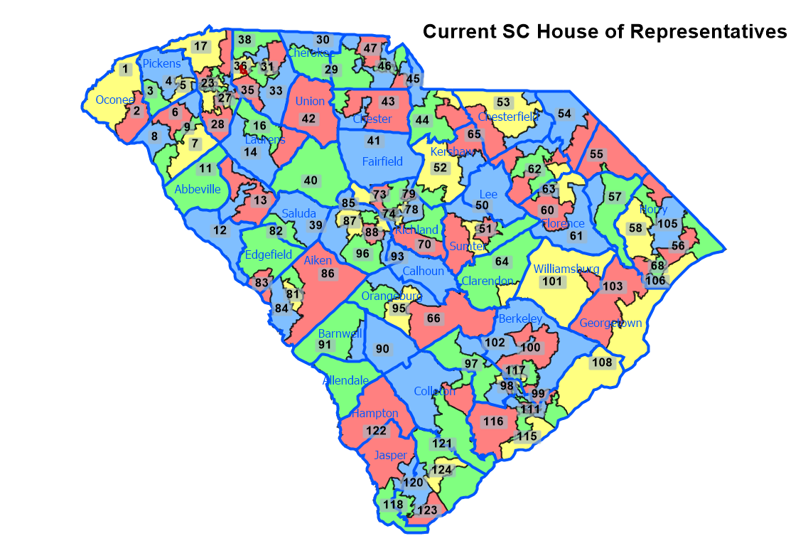
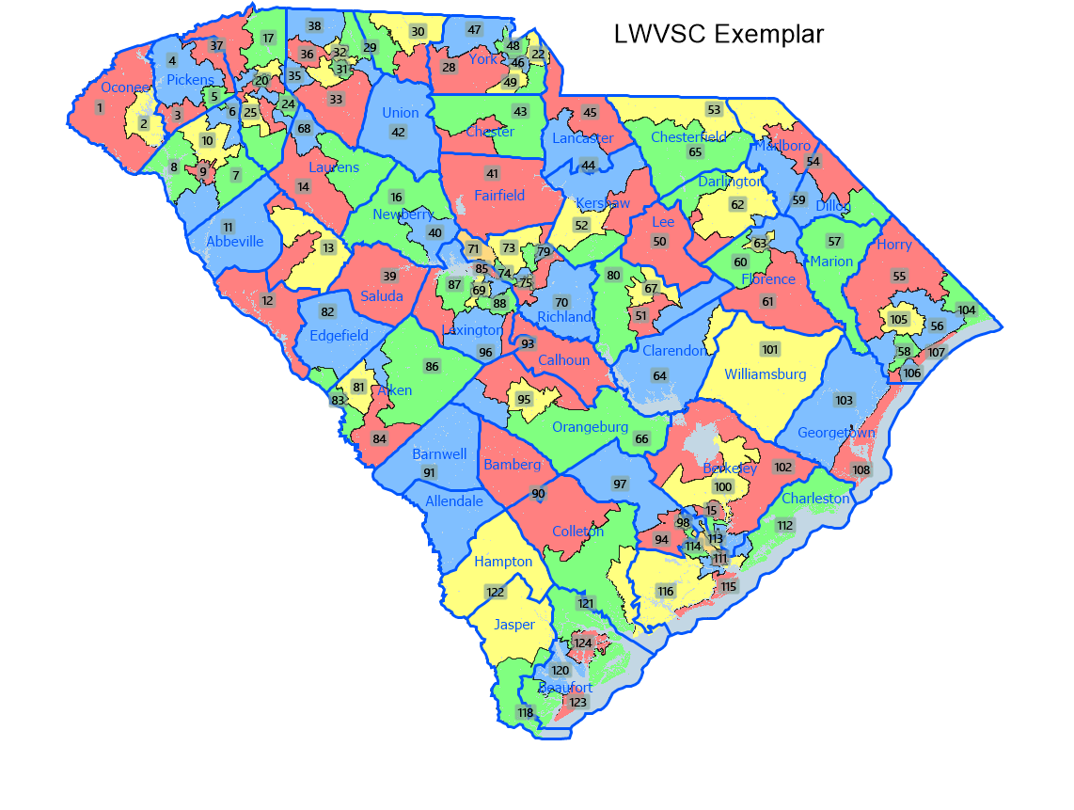
Current SC House plan compared to LWVSC Exemplar

